Slide 1
Predicting Banking Fraud
Adesina Adeniran, Omar Alwehaib, Yifeng Chen, Kaushiki Tiwary

Slide 2
Addressing Bank Fraud
Our machine learning models will accurately predict the onset of bank fraud within the financial industry. Mitigating Bank fraud will help banks with:
Protecting Customer Trust
Financial Loss Prevention
Regulatory Compliance
Operational Efficiency
Risk Management

Slide 3
Table of contents
01
02
03
Our Data
Main Results
Challenges

Slide 4
01
Our data

Slide 5
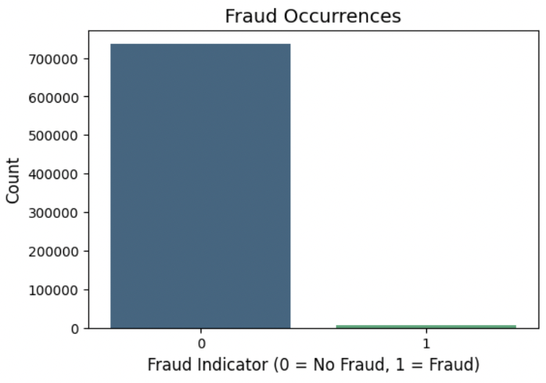
The Dataset: Before Undersampling
1%
742,362
32
Rows
Columns
Fraudulent Records
19 Categorical
12 Numerical
Class imbalance that had to be fixed

Slide 6
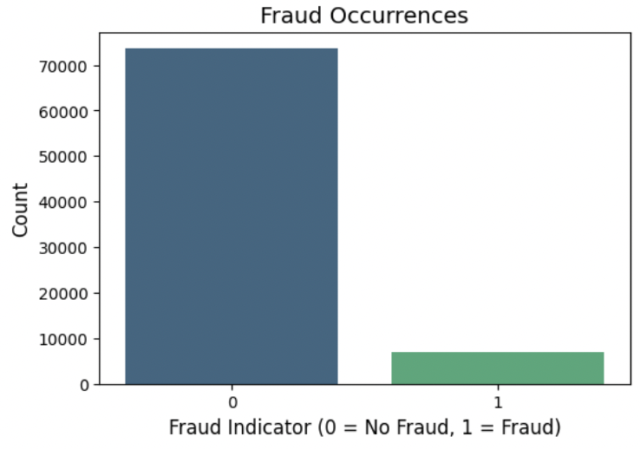
The Dataset: After Undersampling
10%
80,420
30
Rows
Columns
Fraudulent Records
After Feature Selection through Log Reg
More manageable balance of fraud/not fraud
Notes:
80420

Slide 7
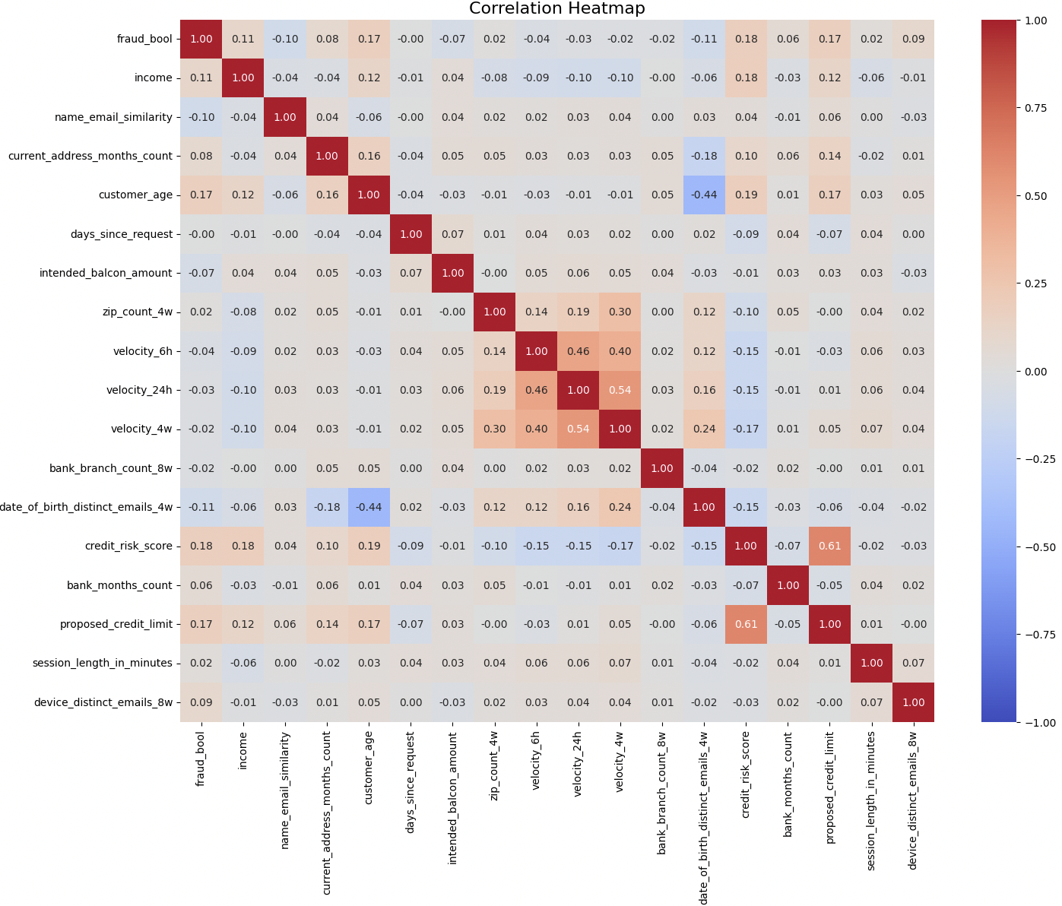
EDA

Slide 8
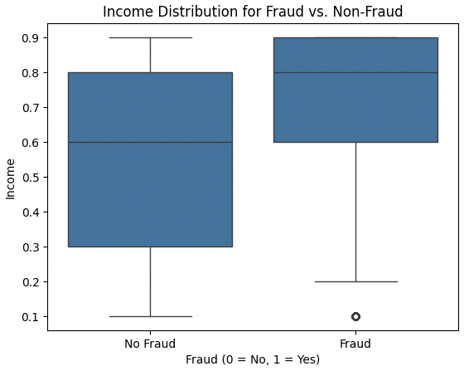
EDA
Outliers
The outliers present on fraudulent accounts raise concerns when associated with low income. Low income accounts may exhibit patterns correlating to higher likelihood of fraudulent activity

Slide 9
Main Results
02

Slide 10
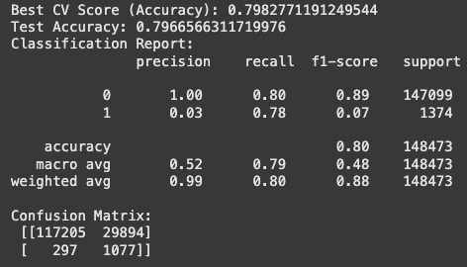
Initial Model: Logistic Reg.
Used imbalanced data
High False Negative Rate (Accounts incorrectly flagged as fraudulent)
Default .50 Threshold
Only 80% overall accuracy

Slide 11
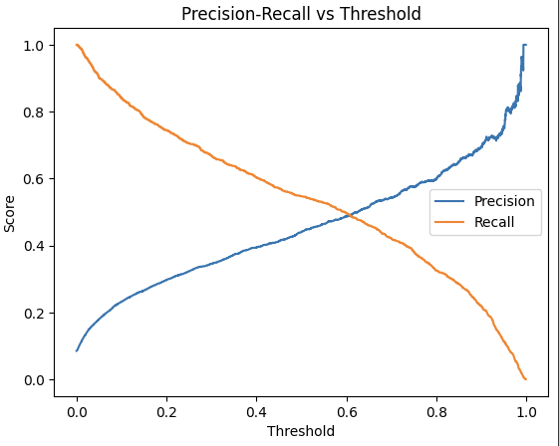
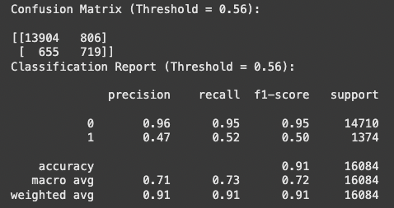
Best Model: XGBoost!
Used all features (No Feature selection)
SMOTE to tackle class imbalance
91% Overall Accuracy
Tuned Threshold

Slide 12
Other Models
XGBoost w/Feature Selection | Random Forest w/Feature Selection | SVM w/Feature Selection
87% overall accuracy | 87% overall accuracy | 85% overall accuracy
0.4 Threshold | 0.4 Threshold | 0.4 Threshold
F1-Score: 94% for positive class 48% for negative class | F1-Score: 93% for positive class 45% for negative class | F1-Score: 91% for positive class 42% for negative class

Slide 13
03
Challenges
And Room for Improvement

Slide 14
Challenges/Room for Improvement
Class Imbalance
Limited Time
Finding an appropriate method to tackle class imbalance
We had limited time to pursue other methods like ensemble and stacking.
Threshold
Size of Data
Picking a threshold that avoided false positives (precision) and captured true positives (recall).As a next step, we could introduce threshold tuning to our other models
Large Data size meant models took hours to run

Slide 15

Thank You!
Any Questions?

